Slide 1
Retrieval Evaluation
Hongning Wang
CS@UVa

Slide 2

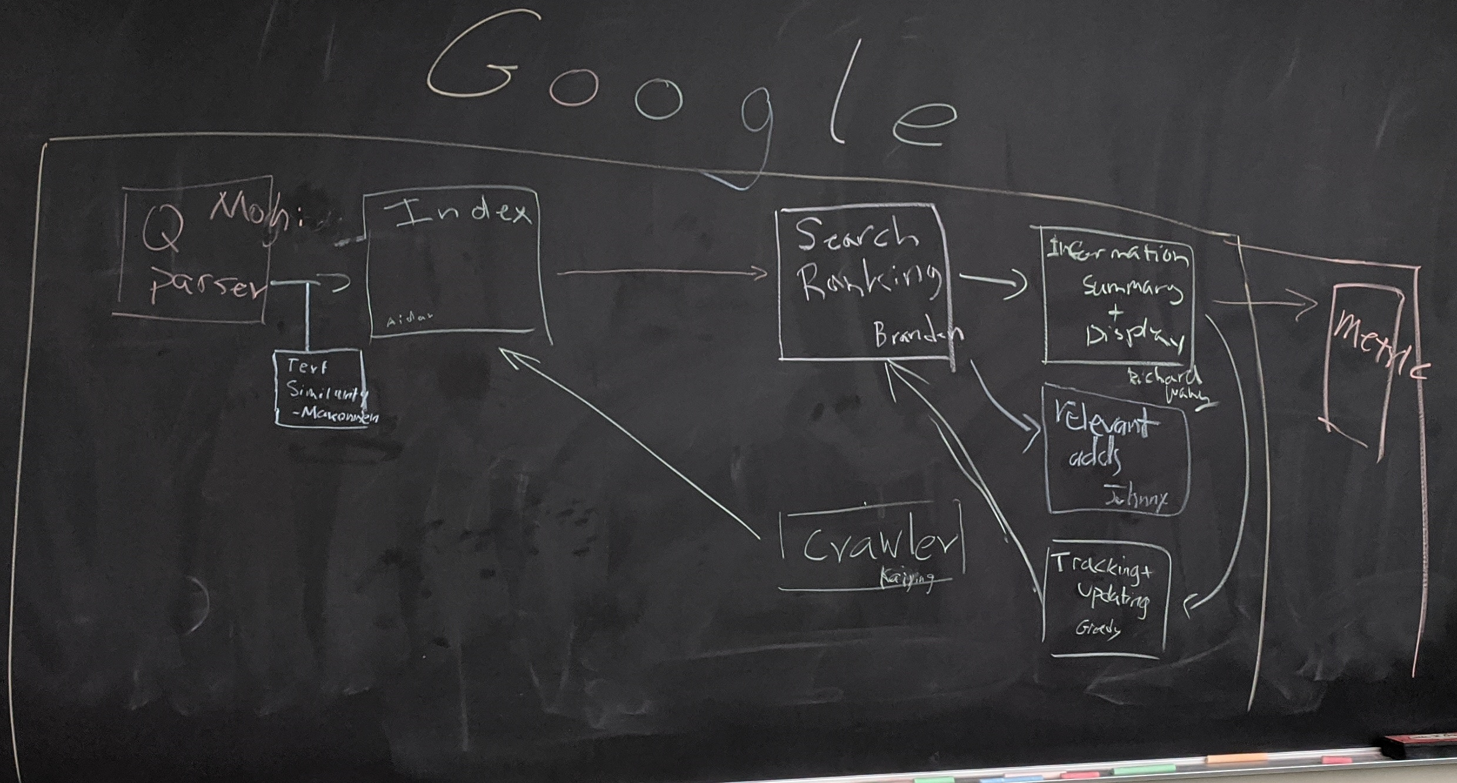

What we have learned so far
Indexed corpus
Crawler
Ranking procedure
Research attention
Feedback
Evaluation
Doc Analyzer
(Query)
User
Query Rep
Doc Rep (Index)
Ranker
Indexer
results
Index

Slide 3
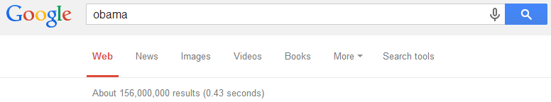

Which search engine do you prefer: Bing or Google?
What are your judging criteria?
How fast does it response to your query?
How many documents can it return?

Slide 4
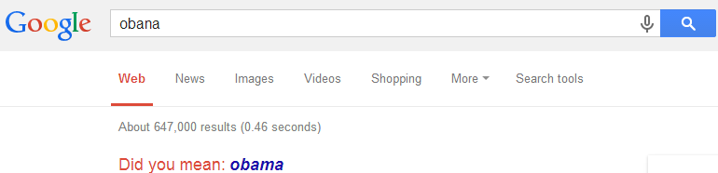
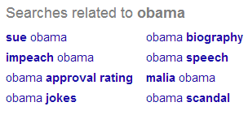
Which search engine do you prefer: Bing or Google?
What are your judging criteria?
Can it correct my spelling errors?
Can it suggest me good related queries?

Slide 5
Retrieval evaluation
Aforementioned evaluation criteria are all good, but not essential
Goal of any IR system
Satisfying users’ information need
Core quality measure
“how well a system meets the information needs of its users.” – wiki
Unfortunately vague and hard to execute

Slide 6
Quantify the IR quality measure
Information need
“an individual or group's desire to locate and obtain information to satisfy a conscious or unconscious need” – wiki
Reflected by user query
Categorization of information need
Navigational
Informational
Transactional

Slide 7
Quantify the IR quality measure
Satisfaction
“the opinion of the user about a specific computer application, which they use” – wiki
Reflected by
Increased result clicks
Repeated/increased visits
Result relevance

Slide 8

Classical IR evaluation
Cranfield experiments
Pioneer work and foundation in IR evaluation
Basic hypothesis
Retrieved documents’ relevance is a good proxy of a system’s utility in satisfying users’ information need
Procedure
1,398 abstracts of aerodynamics journal articles
225 queries
Exhaustive relevance judgments of all (query, document) pairs
Compare different indexing system over such collection

Slide 9
Classical IR evaluation
Three key elements for IR evaluation
A document collection
A test suite of information needs, expressible as queries
A set of relevance judgments, e.g., binary assessment of either relevant or nonrelevant for each query-document pair

Slide 10
Search relevance
Users’ information needs are translated into queries
Relevance is judged with respect to the information need, not the query
E.g., Information need: “When should I renew my Virginia driver’s license?”
Query: “Virginia driver’s license renewal”
Judgment: whether a document contains the right answer, e.g., every 8 years; rather than if it literally contains those four words

Slide 11
Text REtrieval Conference (TREC)
Large-scale evaluation of text retrieval methodologies
Since 1992, hosted by NIST
Standard benchmark for IR studies
A wide variety of evaluation collections
Web track
Question answering track
Cross-language track
Microblog track
And more…

Slide 12
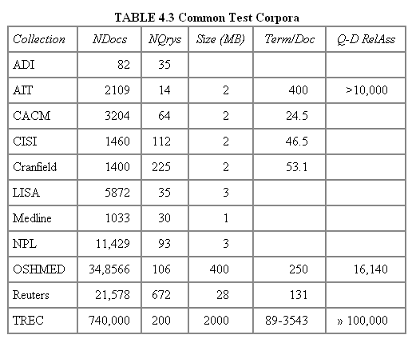
Public benchmarks
Table from Manning Stanford CS276, Lecture 8

Slide 13
Evaluation metric
To answer the questions
Is Google better than Bing?
Which ranking method is the most effective?
Shall we perform stemming or stopword removal?
We need a quantifiable metric, by which we can compare different IR systems
As unranked retrieval sets
As ranked retrieval results

Slide 14


Evaluation of unranked retrieval sets
In a Boolean retrieval system
Precision: fraction of retrieved documents that are relevant, i.e., p(relevant|retrieved)
Recall: fraction of relevant documents that are retrieved, i.e., p(retrieved|relevant)
 | relevant | nonrelevant
retrieved | true positive (TP) | false positive (FP)
not retrieved | false negative (FN) | true negative (TN)
Precision:
$$P=\frac{TP}{TP+FP}$$
Recall:
$$R=\frac{TP}{TP+FN}$$

Slide 15
Evaluation of unranked retrieval sets
Precision and recall trade off against each other
Precision decreases as the number of retrieved documents increases (unless in perfect ranking), while recall keeps increasing
These two metrics emphasize different perspectives of an IR system
Precision: prefers systems retrieving fewer documents, but highly relevant
Recall: prefers systems retrieving more documents

Slide 16

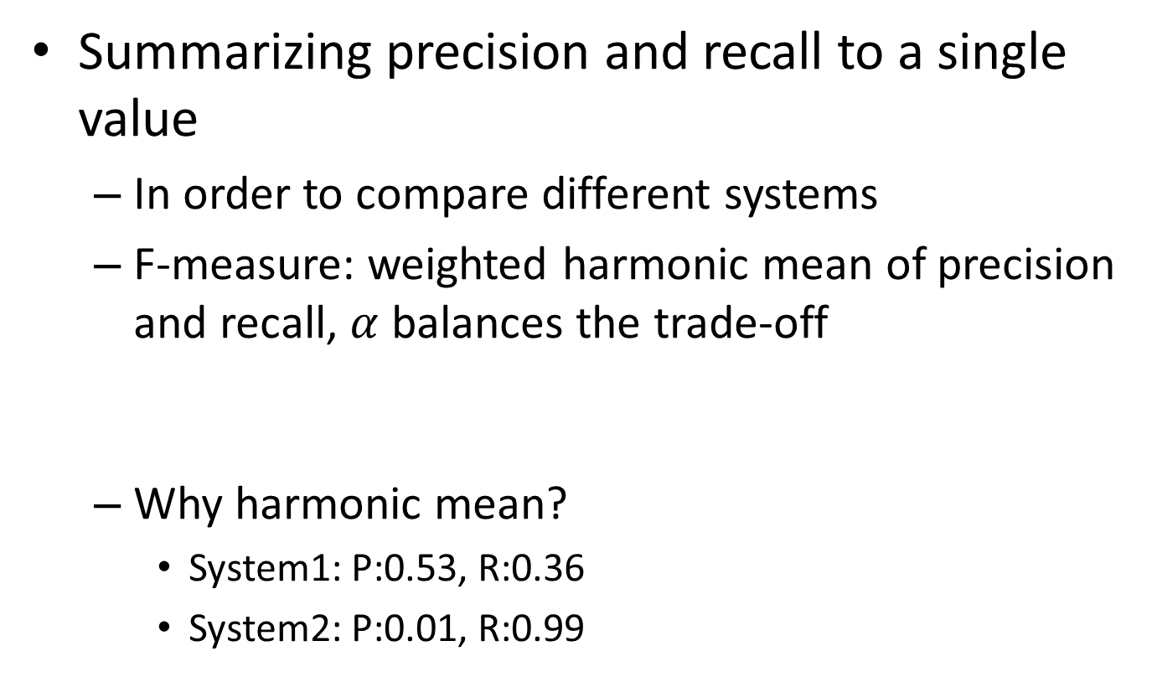

Evaluation of unranked retrieval sets
Summarizing precision and recall to a single value
In order to compare different systems
F-measure: weighted harmonic mean of precision and recall, $α$ balances the trade-off
Why harmonic mean?
System1: P:0.53, R:0.36
System2: P:0.01, R:0.99
$$F=\frac{1}{α\frac{1}{P}+\left(1−α\right)\frac{1}{R}}$$
$$\left(F_{1}=\frac{2}{\frac{1}{P}+\frac{1}{R}} \right)$$
H | A
0.429 | 0.445
0.019 | 0.500
Equal weight between precision and recall

Slide 17

Recap: IR evaluation

Slide 18
Recap: classical IR evaluation
Three key elements for IR evaluation
A document collection
A test suite of information needs, expressible as queries
A set of relevance judgments, e.g., binary assessment of either relevant or nonrelevant for each query-document pair

Slide 19
Evaluation of ranked retrieval results
Ranked results are the core feature of an IR system
Precision, recall and F-measure are set-based measures, that cannot assess the ranking quality
Solution: evaluate precision at every recall point
precision
System1
System2
x
Which system is better?
x
x
x
x
x
x
x
x
recall
x

Slide 20
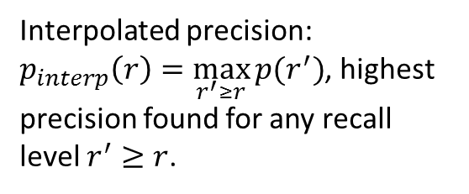
Precision-Recall curve
A sawtooth shape curve
Interpolated precision: $p_{interp}\left(r\right)=\max_{r^{′}≥r}{p(r^{′})}$, highest precision found for any recall level $r^{′}≥r$.

Slide 21
Evaluation of ranked retrieval results
Summarize the ranking performance with a single number
Binary relevance
Eleven-point interpolated average precision
Precision@K (P@K)
Mean Average Precision (MAP)
Mean Reciprocal Rank (MRR)
Multiple grades of relevance
Normalized Discounted Cumulative Gain (NDCG)

Slide 22
Eleven-point interpolated average precision
At the 11 recall levels [0,0.1,0.2,…,1.0], compute arithmetic mean of interpolated precision over all the queries

Slide 23

Precision@K
Set a ranking position threshold K
Ignores all documents ranked lower than K
Compute precision in these top K retrieved documents
E.g.,
P@3 of 2/3
P@4 of 2/4
P@5 of 3/5
In a similar fashion we have Recall@K
Relevant
Nonrelevant

Slide 24

Mean Average Precision
Consider rank position of each relevant doc
E.g.,K₁, K₂, … K_{R}
Compute P@K for each K₁, K₂, … K_{R}
Average precision = average of those P@K
E.g.,
MAP is the mean of Average Precision across multiple queries/rankings
$$AvgPrec=\left(\frac{1}{1}+\frac{2}{3}+\frac{3}{5}\right)/3$$

Slide 25
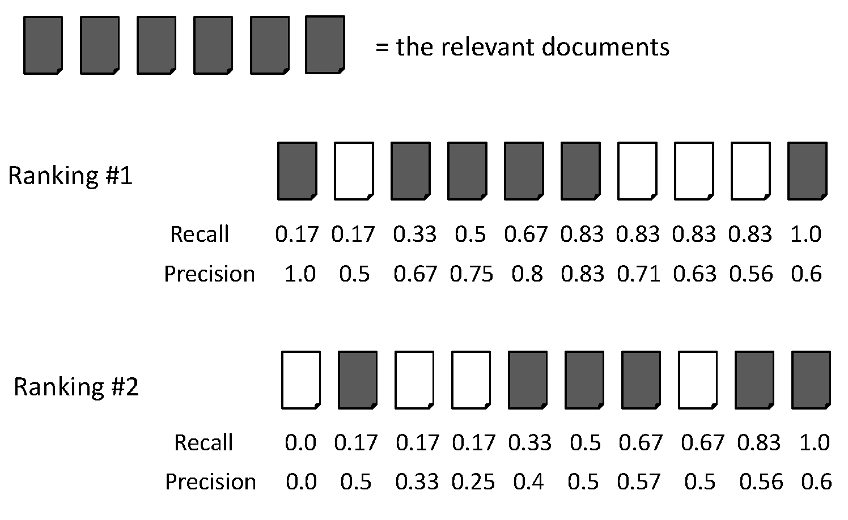
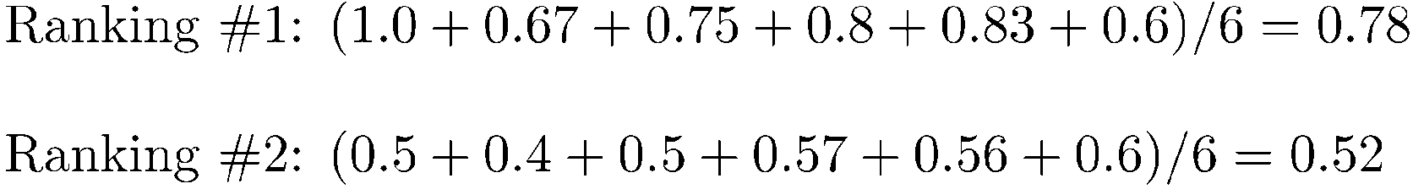
AvgPrec is about one query
AvgPrec of the two rankings
Figure from Manning Stanford CS276, Lecture 8

Slide 26
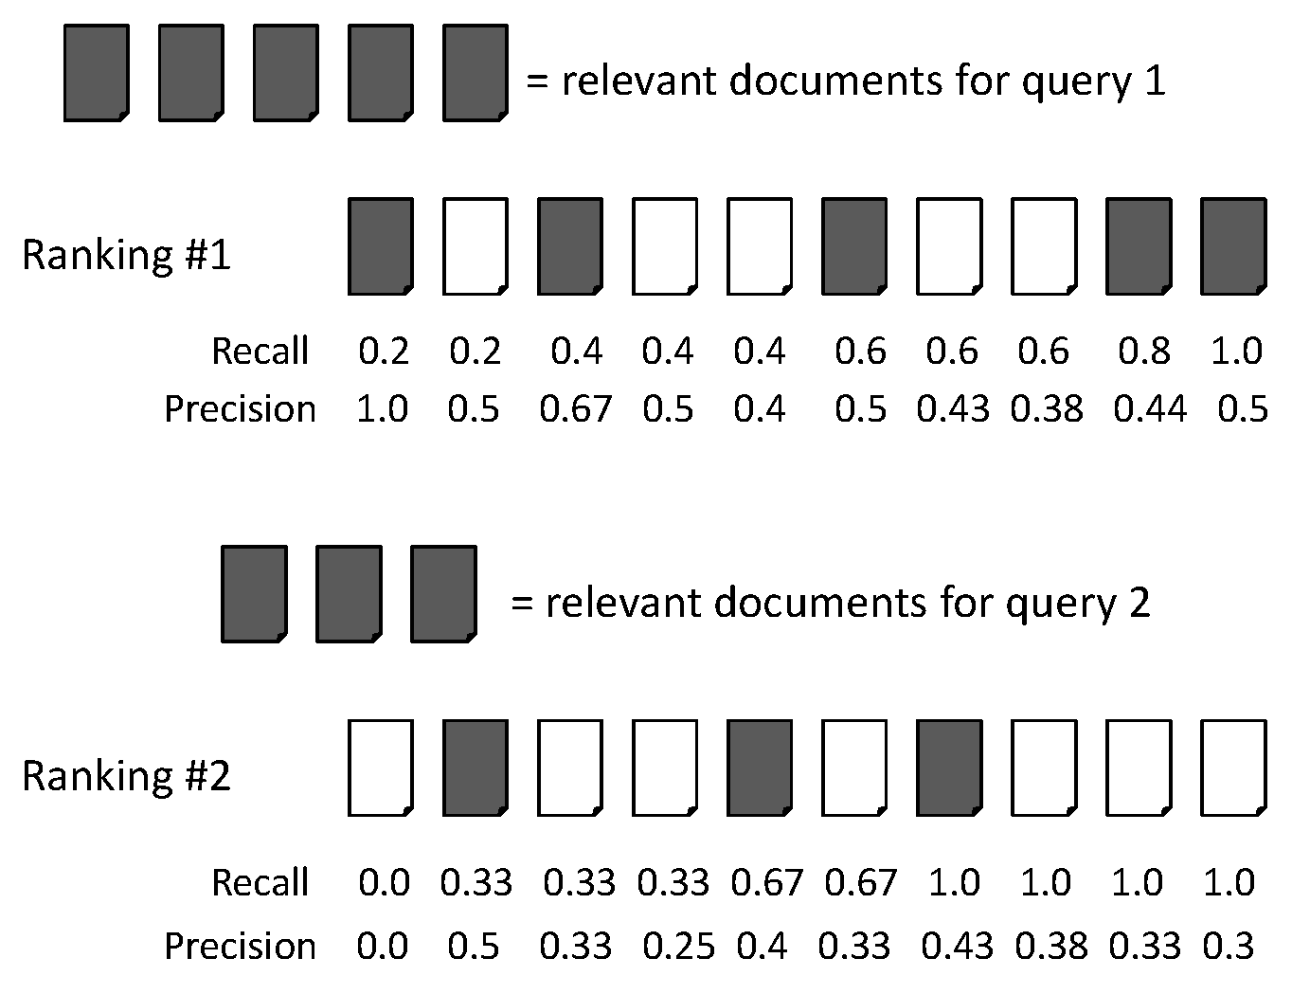
MAP is about a system
Figure from Manning Stanford CS276, Lecture 8
Query 1, AvgPrec=(1.0+0.67+0.5+0.44+0.5)/5=0.62
Query 2, AvgPrec=(0.5+0.4+0.43)/3=0.44
MAP = (0.62+0.44)/2=0.53

Slide 27
MAP metric
If a relevant document never gets retrieved, we assume the precision corresponding to that relevant document to be zero
MAP is macro-averaging: each query counts equally
MAP assumes users are interested in finding many relevant documents for each query
MAP requires many relevance judgments in a text collection

Slide 28
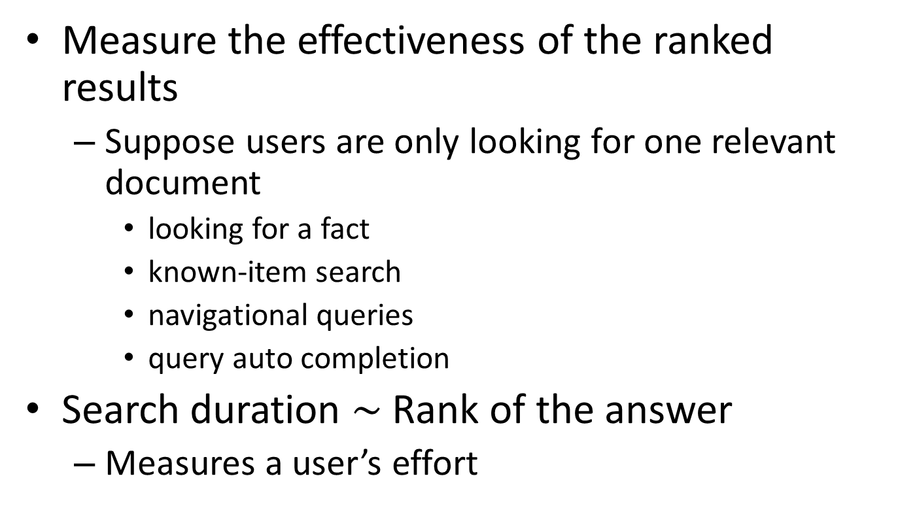
Mean Reciprocal Rank
Measure the effectiveness of the ranked results
Suppose users are only looking for one relevant document
looking for a fact
known-item search
navigational queries
query auto completion
Search duration $\sim$ Rank of the answer
Measures a user’s effort

Slide 29
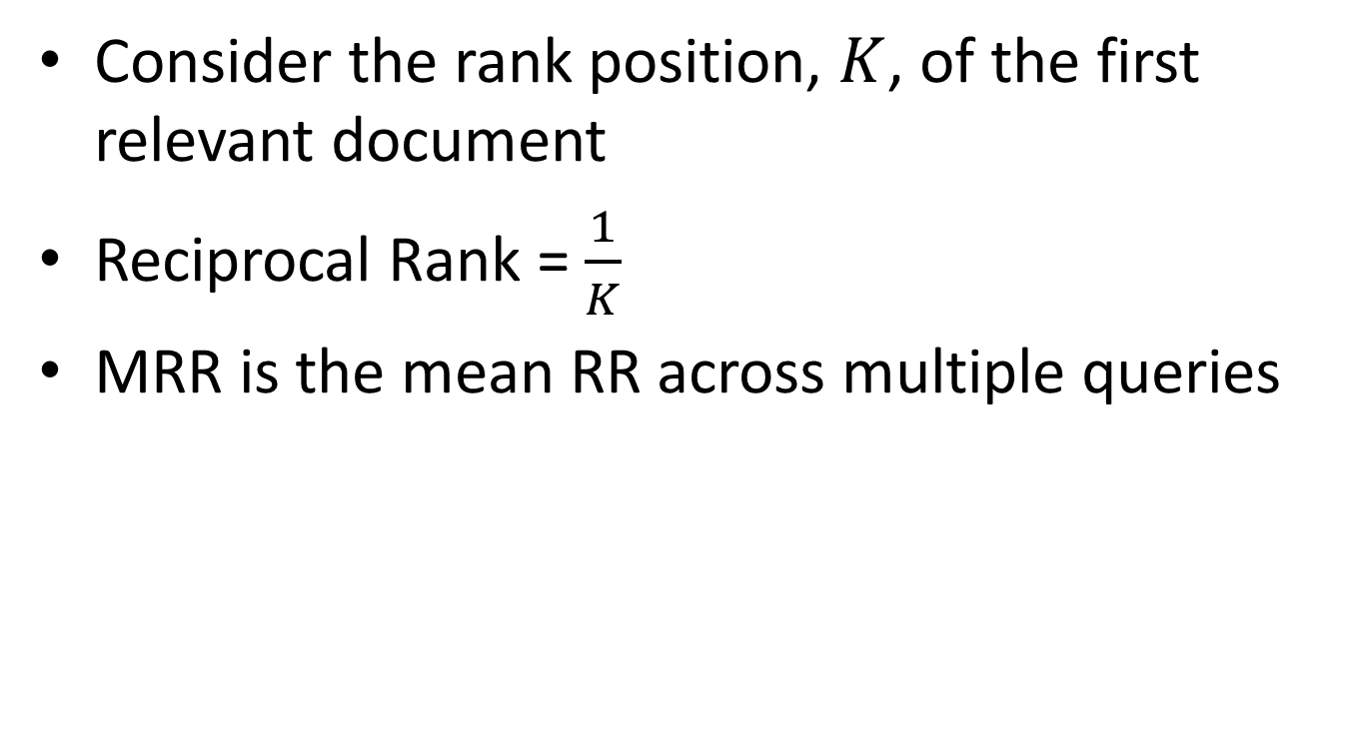
Mean Reciprocal Rank
Consider the rank position, $K$, of the first relevant document
Reciprocal Rank = $\frac{1}{K}$
MRR is the mean RR across multiple queries

Slide 30
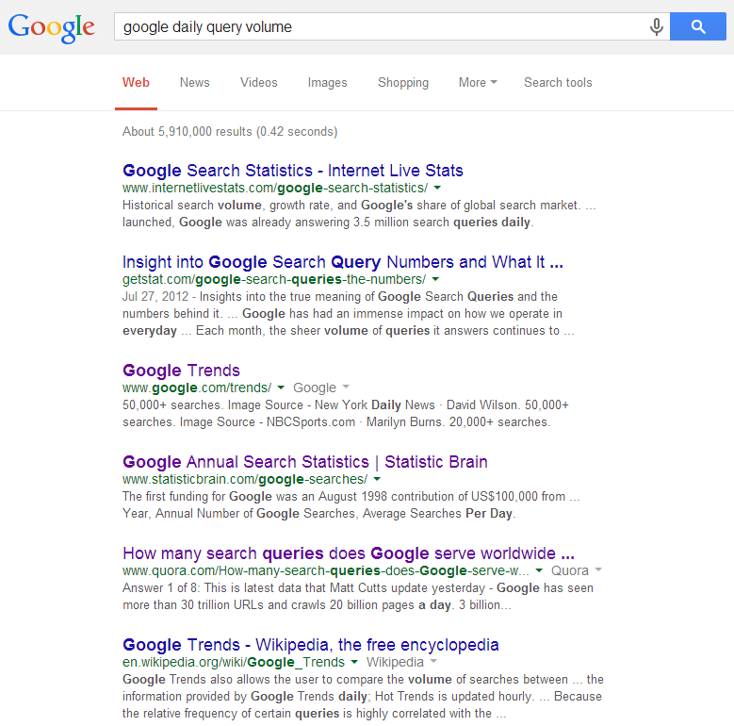
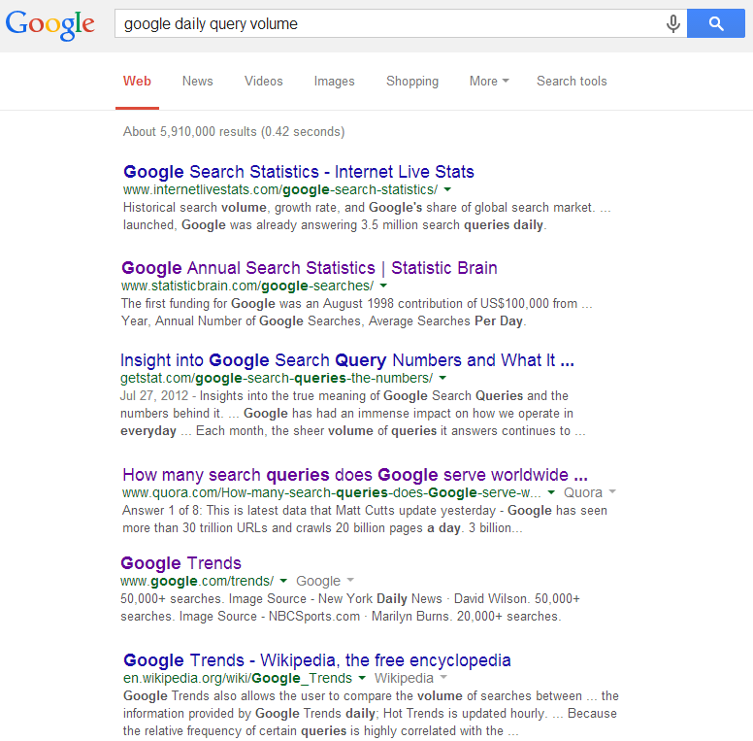
Beyond binary relevance
P@6
MAP
MRR
Excellent
Same P@6?!
Fair
Good
Same MAP?!
Fair
Relevant
Nonrelevant
Bad
Good
Fair
Fair
Bad
Bad
Bad

Slide 31
Beyond binary relevance
The level of documents’ relevance quality with respect to a given query varies
Highly relevant documents are more useful than marginally relevant documents
The lower the ranked position of a relevant document is, the less useful it is for the user, since it is less likely to be examined
Discounted Cumulative Gain

Slide 32
Discounted Cumulative Gain
Uses graded relevance as a measure of usefulness, or gain, from examining a document
Gain is accumulated starting at the top of the ranking and discounted at lower ranks
Typical discount is 1/log (rank)
With base 2, the discount at rank 4 is 1/2, and at rank 8 it is 1/3

Slide 33


Discounted Cumulative Gain
DCG is the total gain accumulated at a particular rank position p:
Alternative formulation
Standard metric in some web search companies
Emphasize on retrieving highly relevant documents
Relevance label at position i
$$DCG_{p}=rel_{1}+\sum_{i=2}^{p}{\frac{rel_{i}}{\log_{2}{i}}}$$
$$DCG_{p}=\sum_{i=1}^{p}{\frac{2^{rel_{i}}−1}{\log_{2}{(1+i)}}}$$

Slide 34
Normalized Discounted Cumulative Gain
Normalization is useful for contrasting queries with varying numbers of relevant results
Normalize DCG at rank n by the DCG value at rank n of the ideal ranking
The ideal ranking is achieved via ranking documents with their relevance labels

Slide 35
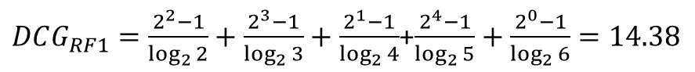
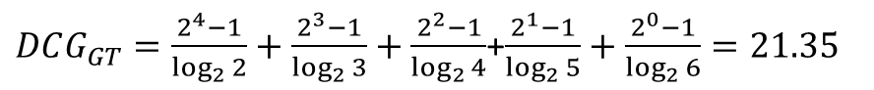
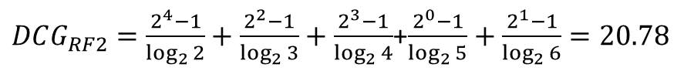
NDCG - Example
How about P@4, P@5, MAP and MRR?
5 documents: d₁, d₂, d₃, d₄, d₅
i | Ground Truth |  | Ranking Function₁ |  | Ranking Function₂
 | Document Order | rel_{i} | Document Order | rel_{i} | Document Order | rel_{i}
1 | d5 | 4 | d3 | 2 | d5 | 4
2 | d4 | 3 | d4 | 3 | d3 | 2
3 | d3 | 2 | d2 | 1 | d4 | 3
4 | d2 | 1 | d5 | 4 | d1 | 0
5 | d1 | 0 | d1 | 0 | d2 | 1
 | NDCG_{GT}=1.00 |  | NDCG_{RF1}=0.67 |  | NDCG_{RF2}=0.97
$DCG_{GT}=\frac{2^{4}−1}{\log_{2}{2}}+\frac{2^{3}−1}{\log_{2}{3}}+\frac{2^{2}−1}{\log_{2}{4}}$+$\frac{2^{1}−1}{\log_{2}{5}}+\frac{2^{0}−1}{\log_{2}{6}}=21.35$
$DCG_{RF1}=\frac{2^{2}−1}{\log_{2}{2}}+\frac{2^{3}−1}{\log_{2}{3}}+\frac{2^{1}−1}{\log_{2}{4}}$+$\frac{2^{4}−1}{\log_{2}{5}}+\frac{2^{0}−1}{\log_{2}{6}}=14.38$
$DCG_{RF2}=\frac{2^{4}−1}{\log_{2}{2}}+\frac{2^{2}−1}{\log_{2}{3}}+\frac{2^{3}−1}{\log_{2}{4}}$+$\frac{2^{0}−1}{\log_{2}{5}}+\frac{2^{1}−1}{\log_{2}{6}}=20.78$

Slide 36
Recap: evaluation of ranked retrieval results
Summarize the ranking performance with a single number
Binary relevance
Eleven-point interpolated average precision
Precision@K (P@K)
Mean Average Precision (MAP)
Mean Reciprocal Rank (MRR)
Multiple grades of relevance
Normalized Discounted Cumulative Gain (NDCG)

Slide 37
Pop-up Quiz
Relevant documents: {A, B, C, D}
Result ranking:
A
D
E
G
F
C
H
P@5, AP, RR, NDCG?

Slide 38
What does query averaging hide?
Figure from Doug Oard’s presentation, originally from Ellen Voorhees’ presentation

Slide 39
Statistical significance tests
How confident you are that an observed difference doesn’t simply result from the particular queries you chose?
Experiment 1
Experiment 2
Query
System A
System B
Query
System A
System B
1
2
3
4
5
6
7
0.20
0.21
0.22
0.19
0.17
0.20
0.21
0.40
0.41
0.42
0.39
0.37
0.40
0.41
11
12
13
14
15
16
17
0.02
0.39
0.26
0.38
0.14
0.09
0.12
0.76
0.07
0.17
0.31
0.02
0.91
0.56
Average
0.20
0.40
Average
0.20
0.40

Slide 40
Background knowledge
p-value in statistic test is the probability of obtaining data as extreme as was observed, if the null hypothesis was true (e.g., if observation is totally random)
If p-value is smaller than the chosen significance level (α), we reject the null hypothesis (e.g., observation is not random)
We seek to reject the null hypothesis (we seek to show that the observation is a random result), and so small p-values are good
40

Slide 41
Tests usually used in IR evaluations
Sign test
Hypothesis: the difference median is zero between samples from two continuous distributions
Wilcoxon signed rank test
Hypothesis: data are paired and come from the same population
Paired t-test
Hypothesis: difference between two responses measured on the same statistical unit has a zero mean value
One-tail v.s. two-tail?
If you aren’t sure, use two-tail

Slide 42
Statistical significance testing
Query
System A
System B
Sign Test
paired t-test
11
12
13
14
15
16
17
0.02
0.39
0.26
0.38
0.14
0.09
0.12
0.76
0.07
0.17
0.31
0.02
0.91
0.56
+
-
-
-
-
+
+
+0.74
-0.32
-0.09
-0.07
-0.12
+0.82
+0.44
Average
0.20
0.40
p=0.7054
p=0.2927
95% of outcomes
0

Slide 43
Where do we get the relevance labels?
Human annotation
Domain experts, who have better understanding of retrieval tasks
Scenario 1: annotator lists the information needs, formalizes into queries, and judges the returned documents
Scenario 2: given query and associated documents, annotator judges the relevance by inferring the underlying information need

Slide 44
Assessor consistency
Is inconsistency of assessors a concern?
Human annotators are idiosyncratic and variable
Relevance judgments are subjective
Studies mostly concluded that the inconsistency didn’t affect relative comparison of systems
Success of an IR system depends on how good it is at satisfying the needs of these idiosyncratic humans
Lesk & Salton (1968): assessors mostly disagree on documents at lower ranks, but measures are more affected by top-ranked documents

Slide 45

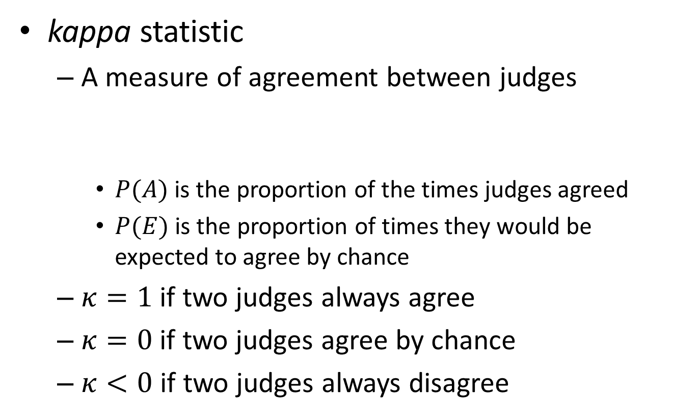
Measuring assessor consistency
kappa statistic
A measure of agreement between judges
$P(A)$ is the proportion of the times judges agreed
$P(E)$ is the proportion of times they would be expected to agree by chance
$κ=1$ if two judges always agree
$κ=0$ if two judges agree by chance
$κ<0$ if two judges always disagree
$$κ=\frac{P\left(A\right)−P(E)}{1−P(E)}$$

Slide 46
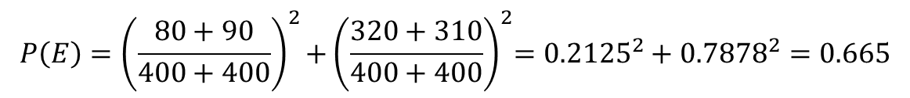
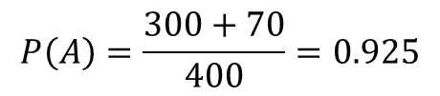
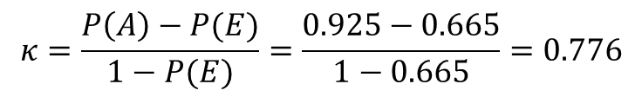
Example of kappa statistic
judge 2 relevance
 | Yes | No | Total
Yes | 300 | 20 | 320
No | 10 | 70 | 80
Total | 310 | 90 | 400
judge 1 relevance
$$P\left(A\right)=\frac{300+70}{400}=0.925$$
$$P\left(E\right)={\left(\frac{80+90}{400+400}\right)}^{2}{+\left(\frac{320+310}{400+400}\right)}^{2}={0.2125}^{2}+{0.7878}^{2}=0.665$$
$$κ=\frac{P\left(A\right)−P(E)}{1−P(E)}=\frac{0.925−0.665}{1−0.665}=0.776$$

Slide 47
Prepare annotation collection
Human annotation is expensive and time consuming
Cannot afford exhaustive annotation of large corpus
Solution: pooling
Relevance is assessed over a subset of the collection that is formed from the top k documents returned by a number of different IR systems

Slide 48
Does pooling work?
Judgments cannot possibly be exhaustive?
Relative rankings among the systems remain the same
What about documents beyond top k?
Relative rankings among the systems remain the same
A lot of research work can be done here
Effective pool construction
Depth v.s., diversity

Slide 49
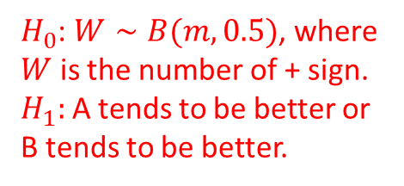
Details about sign test
Query
System A
System B
Sign Test
11
12
13
14
15
16
17
0.02
0.39
0.26
0.38
0.14
0.09
0.12
0.76
0.07
0.17
0.31
0.02
0.91
0.56
+
-
-
-
-
+
+
Assumptions:
1) Comparisons are iid;
2) Comparisons are ordinal.
$H_{0}$: $W∼B(m, 0.5)$, where $W$ is the number of + sign.
$H_{1}:$A tends to be better or B tends to be better.
Average
0.20
0.40
p=0.7054

Slide 50
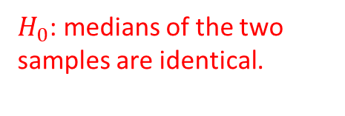
Details about Wilcoxon Signed Test
Query
System A
System B
Wilcoxon Test
11
12
13
14
15
16
17
0.02
0.39
0.26
0.38
0.14
0.09
0.12
0.76
0.07
0.17
0.31
0.02
0.91
0.56
+ 6
- 4
- 2
- 1
- 3
+ 7
+ 5
Assumptions:
1) Comparisons are iid;
2) Comparisons are ordinal.
$H_{0}$: medians of the two samples are identical.
Sum of positive ranks: 18
Sum of negative ranks: 10
Critical value at N=7 is 3
Average
0.20
0.40

Slide 51
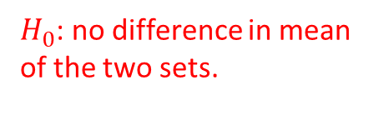
Details about paired t-test
Query
System A
System B
Paired t-test
11
12
13
14
15
16
17
0.02
0.39
0.26
0.38
0.14
0.09
0.12
0.76
0.07
0.17
0.31
0.02
0.91
0.56
+0.74
-0.32
-0.09
-0.07
-0.12
+0.82
+0.44
Assumptions: 1) equal sample size and variance; or 2) equal sample size but different variances.
$H_{0}$: no difference in mean of the two sets.
Average
0.20
0.40
p=0.2927

Slide 52
Rethink retrieval evaluation
Goal of any IR system
Satisfying users’ information need
Core quality measure criterion
“how well a system meets the information needs of its users.” – wiki

Slide 53
What we have considered
The ability of the system to present all relevant documents
Recall-driven measures
The ability of the system to withhold non-relevant documents
Precision-driven measures

Slide 54
Challenge the assumptions in classical IR evaluations
Assumption 1
Satisfaction = Result Relevance
Assumption 2
Relevance = independent topical relevance
Documents are independently judged, and then ranked (that is how we get the ideal ranking)
Assumption 3
Sequential browsing from top to bottom

Slide 55
What we have not considered
The physical form of the output
User interface
The effort, intellectual or physical, demanded on the user
User effort when using the system
Bias IR research towards optimizing relevance-centric metrics

Slide 56
What you should know
Core criterion for IR evaluation
Basic components in IR evaluation
Classical IR metrics
Statistical test
Annotator agreement

Slide 57
Today’s reading
Introduction to information retrieval
Chapter 8: Evaluation in information retrieval

